Slide 1
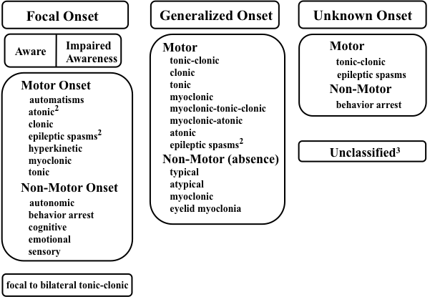
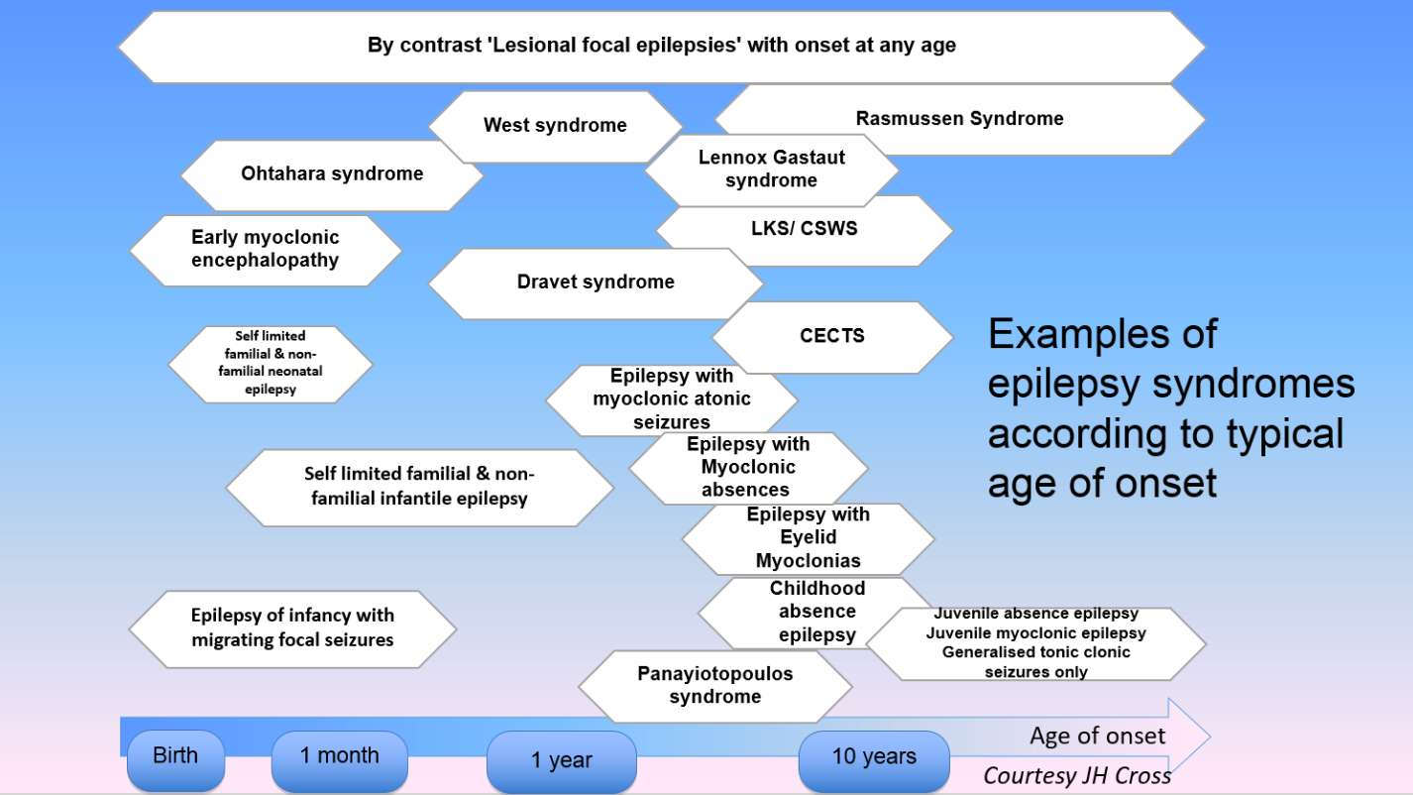


 |  | ILAE classification & useful terms |  | Notes
Description? | “What is the episode(s) like and is the description adequate?” | I have deleted these terms as the keep coming and going in the fashions of epilepsy speak! In reality I think there will be the patient derived description and then a separate professionally validated description using an agreed ontology!!! Both would be free text fields |  | #DESSCRIBE is designed to support the care of children with paroxysmal episodes, particularly where epilepsies are being considered. Without a good description you have almost nothing, worse you may be mislead! Use ongoing histories, good video and demo. Use words correctly. Understand what others mean and be sure that they understand what you mean! Some children have several different types of episode, each needing consideration. Consider whether each episode is epileptic and how certain you are. There is skill in winning confidence whilst being reasonably uncertain. Avoid being confidently wrong! Manage the uncertainty by using time, getting more information, discussing with others. See diagnosis as ongoing refinement rather than a static label you don’t look beyond.
Epileptic? | “Is the episode(s) epileptic? Is this epilepsy? | Epileptic seizure definition: An epileptic seizure is a transient occurrence of signs and/or symptoms due to abnormal excessive or synchronous neuronal activity in the brain. Epilepsy definition:
Seizure type? | “If epileptic, what is the seizure type (s)?” |  |  | Lots of video examples www.epilepsydiagnosis.org
Syndrome? | “Is there an identifiable epilepsy syndrome?” |  |  | Lots of clear definitions and red flags www.epilepsydiagnosis.org
Cause? | “What is the cause of this epilepsy and what further investigations may be needed to explore this?” | Structural | Can be more than one! | www.bpna.org.uk/pet @bpna_org
 |  | Genetic
 |  | Immune
 |  | Infective
 |  | Metabolic
 |  | Uncertain
Relevant… Impairments Behavioural Educational | “Are there any relevant impairment,, behavioural or educational, emotional problems?” | Common examples: ADHD | Anxiety disorder | Autism spectrum disorder | Cerebral palsy | Childhood emotional disorder | DCD – Developmental Coordination Disorder | Depression | Developmental language disorder | Disorder of fluency | DSD – Developmental Speech Disorder | Dyscalculia | Dysgraphia | Dyslexia | Hearing impairment | Intellectual disability | Obsessive-compulsive disorder | Sleep disorder | Tic disorder | Visual impairment | ADHD | Anxiety disorder | Autism spectrum disorder | Cerebral palsy | Childhood emotional disorder | DCD - developmental coordination disorder | Depression | Language disorder | Disorder of fluency | Dyscalculia | Dysgraphia | Dyslexia | Hearing impairment | Intellectual disability | Obsessive-compulsive disorder | Sleep disorder | Tic disorder | Visual impairment (from BCAD Neurodisability-SNOMED mapped terms)
#DESSCRIBE
Epilepsy is a disease of the brain defined by any of the following conditions
1. A least two unprovoked (or reflex) seizures occurring >24 h apart 2. One unprovoked (or reflex) seizure and a probability of further seizures similar to the general recurrence risk (at least 60%) after two unprovoked seizures, occurring over the next 10 years 3. Diagnosis of an epilepsy syndrome
@drcolindunkley, 2018

